Slide 1
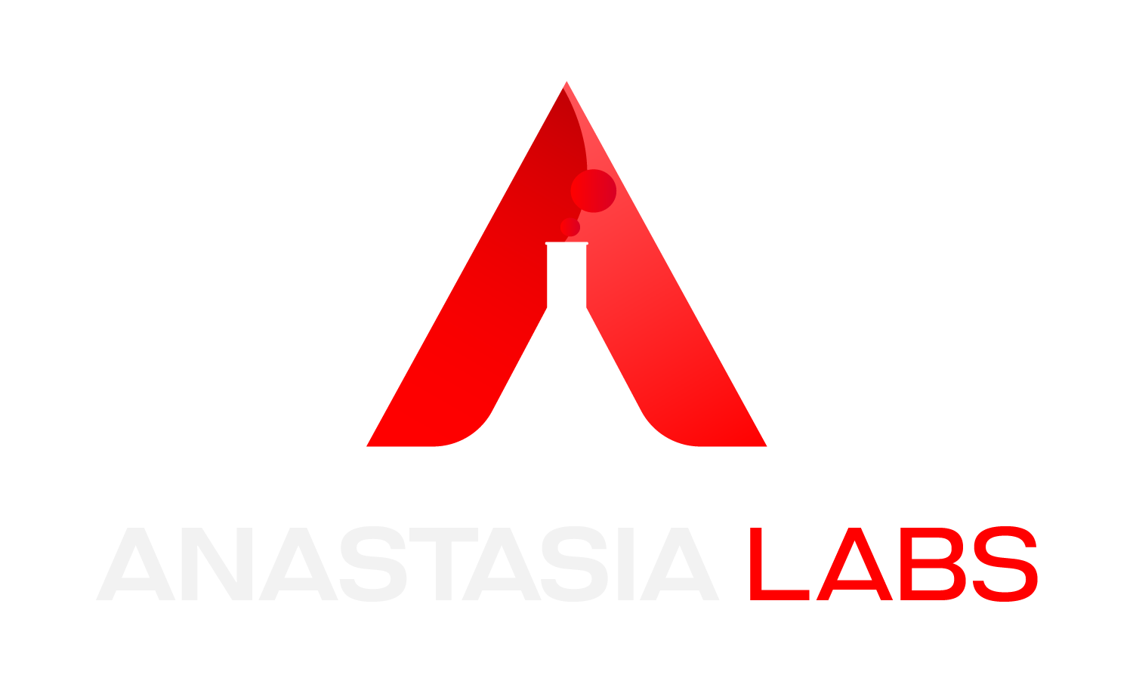
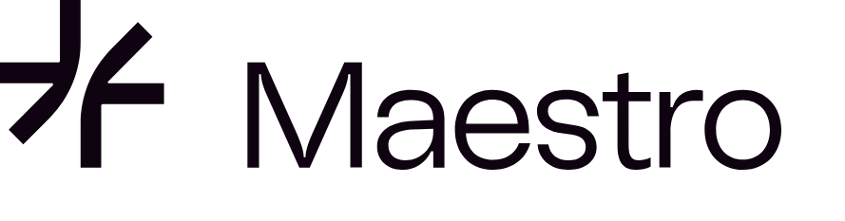
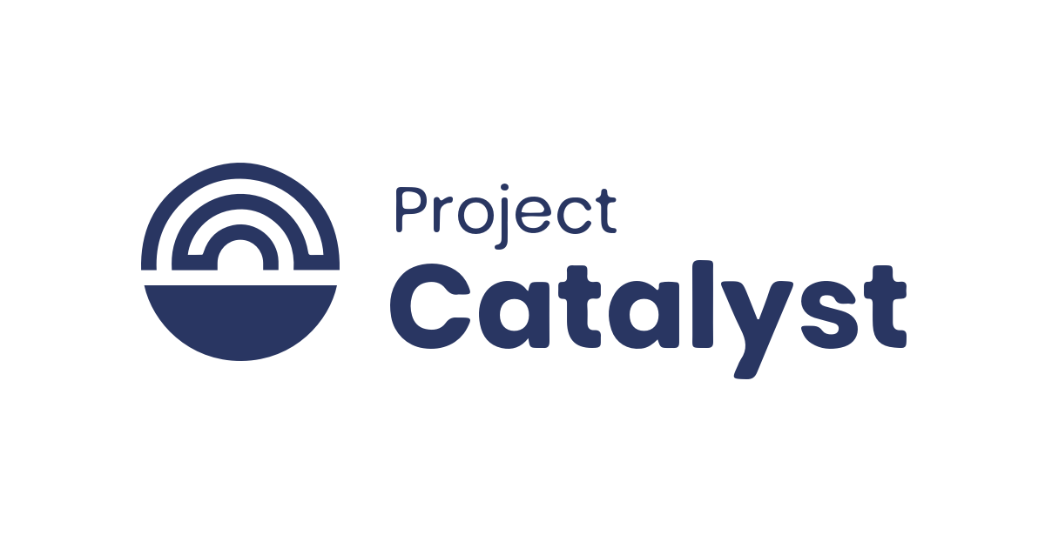

Fund 11
Notes:
Hello, Cardano builders!
Welcome to the close-out report for our Catalyst Fund 11 project:

Slide 2
Anastasia Labs X Maestro - Plug n’ Play 2
Notes:
“Plug ’n Play 2.0, a collaboration between Anastasia Labs and Maestro.”
“I’m [Name], and today we’ll recap our journey: why we built Plug ’n Play 2.0, how we executed each phase, our key outcomes, lessons learned, and what comes next.”

Slide 3
Project Context and Importance
Cardano dApp deployment remains complex due to on-chain/off-chain code barriers. We set out to lower that barrier with no-code smart-contract APIs.
Notes:
“The Cardano ecosystem boasts rapid growth, but deploying secure smart contracts often demands deep Plutus/ Haskell or Aiken expertise. That complexity slows innovation. Plug ’n Play 2.0 set out to change that, offering ready‐made, secure and robust contracts with a no-code interface.”

Slide 4
Project Objectives
Write modular Aiken contracts (multisig & subscription).
Build TypeScript off-chain SDKs.
Expose REST endpoints on Maestro.
Ship docs, tests & demo videos.
Notes:
Our four objectives were:
- Architect upgradable multisig and subscription contracts in Aiken;
- Wrap them in intuitive TypeScript SDKs;
- Publish managed REST endpoints on Maestro;
- and back it all with top-notch docs, tests, and walkthrough videos.

Slide 5
Execution and Milestones
We divided our project into five phases.
Phase 1: Aiken Contract Development
Phase 2: Off-Chain SDKs
Phase 3: API Integration
Phase 4: Integration Testing
Phase 5: Documentation & Video
Notes:
We structured the project into five phases.
\
- Phase 1 tackled contract design and unit tests.
- Phase 2 produced SDKs for off-chain integration.
- In Phase 3 we wired everything into Maestro’s REST APIs.
- Phase 4 validated end-to-end flows under all edge cases. Finally,
- Phase 5 where we are wrapping up with user guides and this project close-out film.

Slide 6
Phase 1: Aiken Contract Development
We successfully designed and developed the two main Smart Contracts in Aiken.
Upgradable MultiSig: dynamic signer and threshold management
Subscription Payments: wallet-UTxO chaining for recurring flows
Notes:
In Phase 1, we authored two on-chain contracts in Aiken.
- The multisig contract enforces multi-signature spending, supports live threshold changes, and dynamic signer add/removal—no redeploy needed.
- The subscription contract chains UTxOs for trustless, recurring payments, and even supports optional penalty-fees for early cancellations; every scenario covered by unit- and property-based tests.

Slide 7
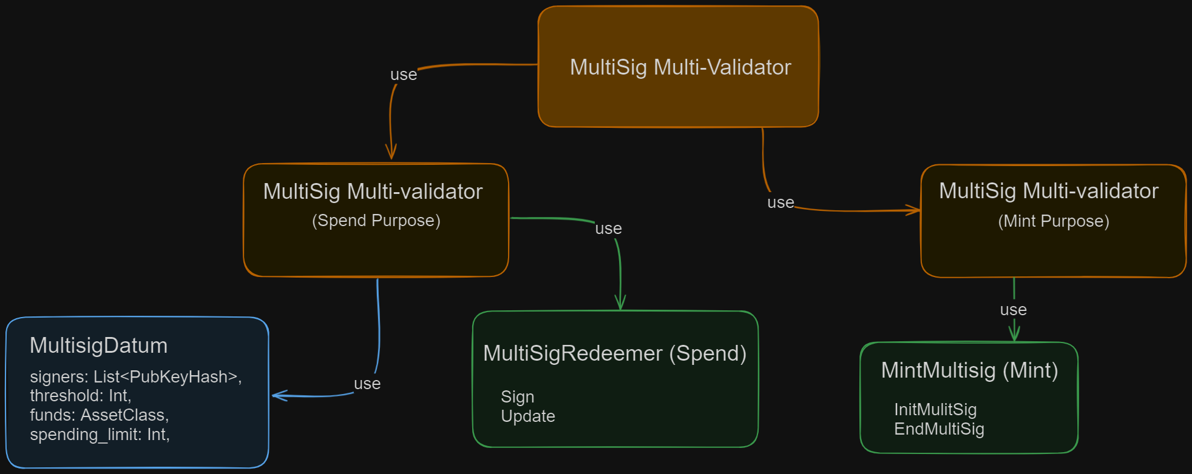
Aiken Upgradable Multisig
Enables users to execute asset transactions within predefined thresholds.
Notes:
The Aiken Upgradable Multisig Smart Contract is a powerful tool for managing digital assets on the Cardano blockchain.
It enables authorized members to execute asset transactions and updates within predefined thresholds. It allows for secure spending of assets, seamless adjustment of signer thresholds, and dynamic addition or removal of signers for enduring usability.

Slide 8
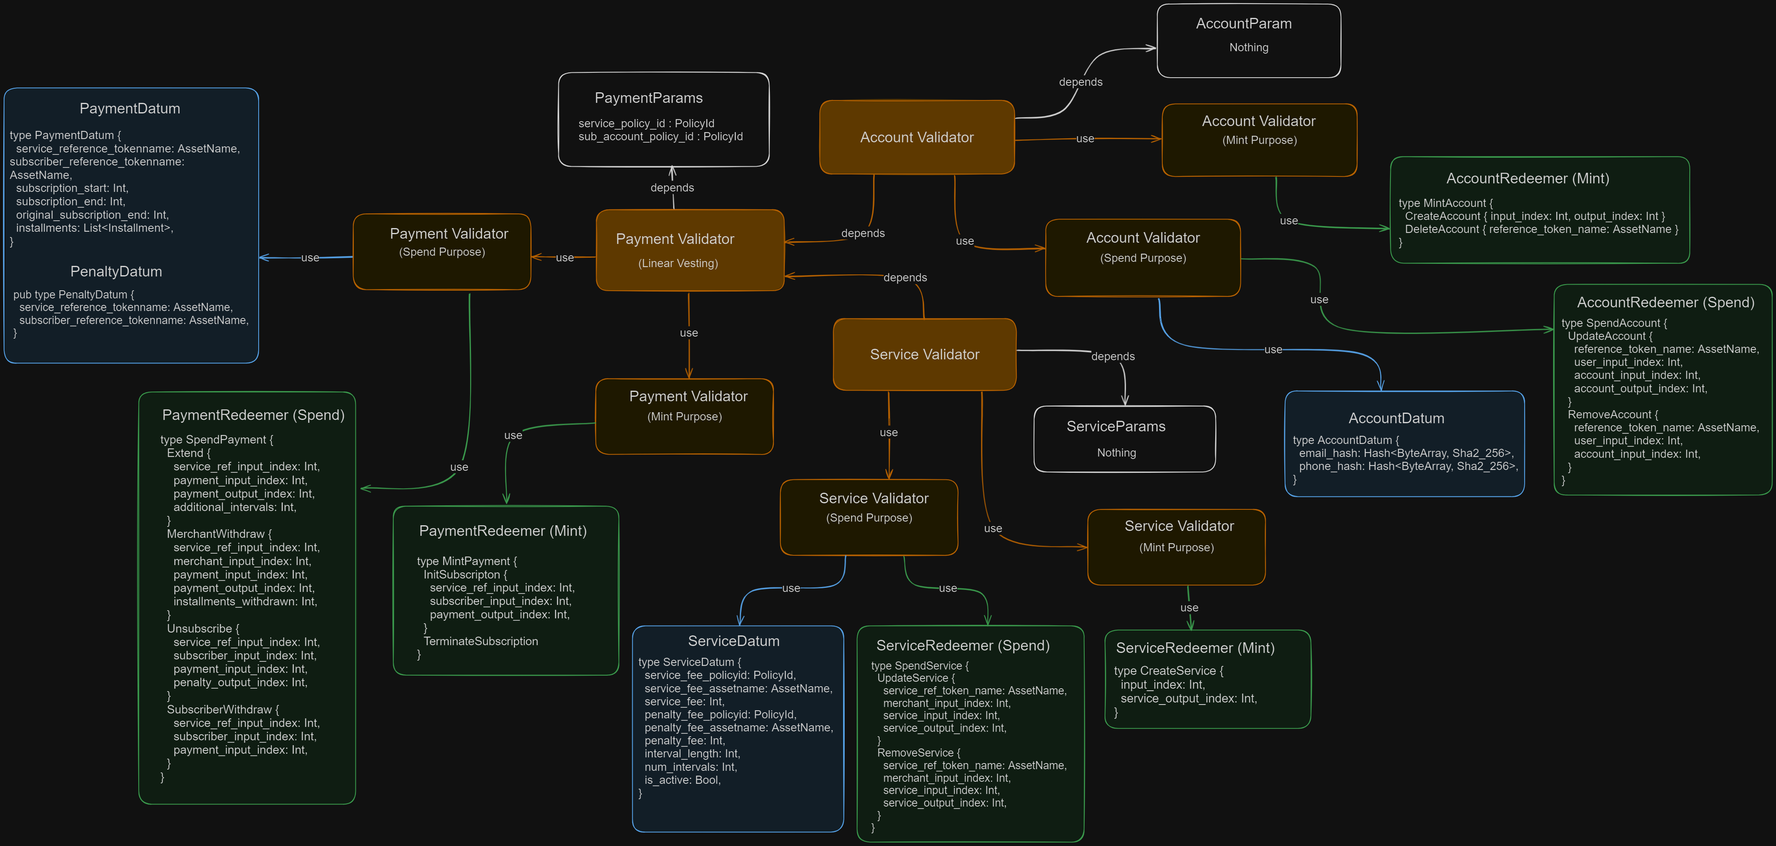
Payment Subscription Smart Contract
This enables users to effortlessly manage recurring payments directly from their wallets.
Notes:
The Subscription contract is designed to facilitate recurring payments on the Cardano blockchain. It allows users to set up automated, scheduled transactions, ensuring timely and consistent payments without manual intervention. This feature is particularly useful for subscription-based services, memberships, and any scenario requiring regular payments.

Slide 9
Phase 2: Off-Chain SDK Building
TypeScript modules for transaction building, signing, submission
Unit tests & example apps
Notes:
Phase 2 focused on user-friendly SDKs, it exposed functions like *`createService()`* for merchants, *`createAccount()`* for users, *`initiateSubscription()`* to start, *`unsubscribe()`* to cancel with optional penalty, and *`withdrawFees()`* for merchants.
The multisig SDK provides *`initiateMultisig()`* to set up wallets, *`validateSign()`* for partial signatures, *`validateUpdate()`* for adding/removing signers, and endMultiSig() to close out.
Each method is backed by clear TS types and unit tests.”

Slide 10
Phase 3: Smart Contract API Integration
In collaboration with Maestro, we integrated our Smart Contracts into a fully managed service, enabling developers to interact with them via APIs.
Endpoints deployed at gomaestro.org/smart-contracts
Postman collections & interactive docs
Notes:
In Phase 3, we mapped SDK calls to Maestro’s managed REST API.
For example,
merchants hit POST /subscription/create-service with service-fee details and interval length.
Subscribers call POST /subscription/initiate with service and account IDs.
For multisig, teams use POST /multisig/initiate and POST /multisig/sign.
We published interactive docs and Postman IDs for easy exploration.

Slide 11
Phase 4: Integration Testing
We conducted rigorous testing for each contract to ensure they meet the highest standards of reliability and performance.
End-to-end tests: success, edge, error paths
97% pass rate; CI coverage reports & logs on GitHub
Notes:
We conducted thorough testing for each smart contract in our library to ensure their robustness. This rigorous process involved comprehensive code reviews and unit tests, all integrated into our continuous integration/continuous deployment (CI/CD) pipeline. This testing was essential to validate the functionality, reliability, security and performance of our solutions.

Slide 12
Phase 5: Documentation
We created user-friendly documentation to help developers of all skill levels understand and implement the APIs. Our documentation includes detailed guides, practical examples, diagrams, step by step instructions and tutorials.
Notes:
We provided comprehensive and user-friendly documentation including detailed guides, practical examples, diagrams and tutorials to facilitate easy adoption and implementation of our smart contracts. The documentation was designed to cater to developers of all skill levels for a smooth onboarding process.

Slide 13
Aiken Upgradable Multisig: Execution Demo
Notes:
Here’s an example execution demo of the Aiken Upgradable MultiSig Contract

Slide 14
Aiken Upgradable MultiSig: Resources
Detailed guides and practical examples can be found at:
Contract: https://github.com/Anastasia-Labs/aiken-upgradable-multisig
SDK: https://github.com/Anastasia-Labs/aiken-multisig-offchain
APIs: https://www.gomaestro.org/smart-contracts
Notes:
Detailed guides and practical examples of our Single Asset Staking Contract can be found in the following links:

Slide 15
Payment Subscription: Execution Demo
Notes:
Let’s have a look at an example execution demo of the Payment Subscription Contract

Slide 16
Payment Subscription: Resources
Detailed guides and practical examples can be found at:
Contract: https://github.com/Anastasia-Labs/ payment-subscription
SDK: https://github.com/Anastasia-Labs/ payment-subscription-offchain
APIs: https://www.gomaestro.org/smart-contracts

Slide 17
Achievements and Outcomes
Implementation of secure, modular and reusable APIs for the Payment Subscription Smart Contract and The Aiken Upgradable Multisig Contract.
Quality Assuarance through conducting rigorous code reviews and comprehensive unit tests.
Seamless Integration With Maestro.
Notes:
We're pleased to highlight the key achievements of our project, which provide a strong base for further innovation in the Cardano ecosystem:
- *Implementation of Secure and Modular APIs:* Our team delivered secure, modular, and reusable APIs for the Aiken Upgradable Multisig Smart and the Payment Subscription Contract. These APIs simplify the development process by reducing the time needed to build and deploy smart contracts, allowing developers to focus on more complex, application-specific logic.
- *Quality Assurance:* We prioritized the robustness and reliability of our smart contracts by conducting thorough code reviews and comprehensive unit tests. This extensive testing ensures our contracts are secure, reliable, and ready for real-world deployment.
- *Seamless Integration:* To further ease development, we successfully integrated our smart contracts with Maestro, providing a unified interface for contract deployment and management. This integration simplifies access and interaction with our contracts, making the development process more efficient.

Slide 18
Achievements (Cont’d)
Extensive documentation and Tutorials to help developers quickly understand and implement our solutions
Industry Collaborations and Community Engagement at the 2023 Dubai Summit.
Notes:
- *Extensive Documentation and Tutorials:* As demonstrated, we are proud to have enriched the Cardano community with rich resources by providing comprehensive documentation and tutorials to help developers quickly understand and utilize our solutions.
- *Industry Collaboration and Community Engagement:* We are happy to have collaborated with Maestro, a Key player in the Cardano ecosystem who also deployed both Contracts on Maestro platform.

Slide 19
Key Learnings and Challenges
Effectiveness of Modular Design and Security.
Importance of simplifying the integration process.
The importance of balancing customization and standardization
The value in comprehensive documentation and monitoring.
Notes:
Throughout the project, we faced several challenges that provided us with valuable insights. Here are the key learnings we've gathered:
- *First, Modular Design and Security.* We've seen the effectiveness of modular, reusable smart contracts. These contracts not only simplify the development process but also enhance security. By providing pre-built, battle-tested contracts, we allow developers to focus more on innovation. Rigorous testing has ensured these contracts are robust against vulnerabilities.
- *Second, Simplifying Integration.* We've learned that simplifying the integration process through APIs is crucial. It lowers the barriers for developers, whether they're part of small teams or large enterprises. This simplicity is key to fostering ecosystem growth and encouraging more developers to build on Cardano.
- *Third, Balancing Customization with Standardization.* Striking a balance between offering customizable solutions and maintaining standardized interfaces is essential. This balance provides the necessary flexibility while ensuring consistency, which is critical to cater to a broad range of developer needs.
- *Lastly, Comprehensive Documentation and Monitoring.* Detailed documentation and user-friendly tutorials are vital for effective developer onboarding. Additionally, implementing monitoring tools for API usage helps us understand user needs and make data-driven improvements. This ensures we can continually refine our offerings to better serve the community.

Slide 20
Future Prospects & Community Impact
Expand Smart Contract Library.
Enhance API Documentation.
Optimize Performance and Scalability.
Collaboration with Ecosystem Partners.
Continuous Feedback.
Long Term Commitment.
Notes:
- *Expand Smart Contract Library:* We aim to develop and integrate additional smart contracts, driven by developer feedback and evolving ecosystem needs. This will ensure that our platform remains a valuable resource for the growing Cardano developer community.
- *Enhance API Documentation:* We will improve our API documentation by adding more examples, use cases, and best practices, making it even easier for developers to utilize our services effectively.
- *Optimize Performance and Scalability:* As the use of our smart contract APIs grows, we will monitor performance closely and optimize to ensure high availability and responsiveness, even under heavy load and as the Cardano ecosystem evolves.
- *Collaborate with Ecosystem Partners:* We plan to engage with other projects and partners within the Cardano ecosystem to explore integration opportunities, expanding the reach and adoption of our smart contract APIs.
- *Continuously Gather Feedback:* We will maintain an open dialogue with the developer community, regularly soliciting feedback and suggestions. This input will guide our future development, ensuring we continue to meet the needs of Cardano builders.
- *Long-Term Commitment:* We will keep our libraries up-to-date with the ever-evolving Cardano ecosystem, ensuring our data structures remain relevant. By maintaining the open-source approach and transparent development process, we believe will inspire confidence and trust within the community.

Slide 21
Conclusion
The project has developed and deployed secure, modular and reusable smart contracts with comprehensive off-chain SDKs, APIs and extensive documentation.
Added to the arsenal of tools that enhance the capabilities of DApps on Cardano.
Notes:
In conclusion, we're proud to have introduced the 'Plug n' Play 02' smart contract library to the Cardano community. Together with Maestro, we have managed to develop secure, modular, and reusable smart contracts, create comprehensive off-chain SDKs, integrated with API endpoints and provide extensive documentation, ultimately supporting the creation of no-code DApps, making it easier for a wider range of users to build on Cardano.
These achievements enhance the capabilities of DApps on Cardano, offering developers valuable tools to innovate and secure their applications. The no-code DApps feature, in particular, opens up blockchain development to those without programming skills, democratizing access to this technology.
We believe our work will inspire further innovation and drive adoption within the Cardano ecosystem. We're committed to supporting the developer community and continually improving our offerings to meet their evolving needs, ensuring that our library remains a vital resource for the platform's growth.

Slide 22
Links
Plug-n-Play: https://github.com/Anastasia-Labs/plug-n-play-contracts
Anastasia Labs: https://anastasialabs.com
Maestro: https://www.gomaestro.org/smart-contracts
Twitter / X: https://x.com/AnastasiaLabs
Discord: https://discord.com/invite/8TYSgwthVy
Notes:
For more information on the project or Anastasia Labs, visit our GitHub repository at:

Slide 23
Thank You!
Notes:
See you next time!
Thank You and Goodbye!

